Slide 1
Big Mountain Resort:
An Analysis

Slide 2
Problem Identification
Big Mountain Resort recently installed a new chairlift with a $1,500,000 price tag
The big question: How do we maximize ticket sales and minimize operational costs to not only pay off the new installment, but to also have a lucrative season overall?
In order to do so, we must analyze which facilities at the lifts that skiers use the most and make the most use of them; conversely, we must identify which facilities skiers use the least
Doing so will result in a ticket value that both maximizes the most commonly used facilities and minimizes costs and usage of the least used facilities

Slide 3
Problem Identification, part 2
The biggest and most obvious constraint in this analysis is the seasonality. As skiing takes place exclusively during cold months (i.e. late Fall to early Spring), we have roughly 6 months to accurately analyze such a finding
Stakeholders responsible for providing key insight are Jimmy Blackburn, Director of Operations, and Alesha Eisen, the Database Manager
In order to access such intricate information, Ms. Eisen provided me with a CSV file; I also used SQL and an S3 bucket

Slide 4
Recommendations & Key Findings
The key findings from this analysis are that the salient features from this resort are the lifts, the vertical drop, snowmaking machines, the number of runs, the lengths of the runs, the number of trams, and the amount of skiable area
Given the aforementioned features from the resort, I recommend the following: that you use the scenario from 5.9.3 (featured in the following slides); specifically, that you open an extra run, increase the vertical drop by 150 feet, and include an additional two acres of snowmaking
In addition to the recommended implementation, I will include other possible scenarios in the following slides

Slide 5
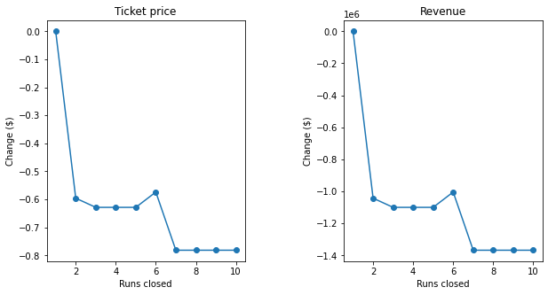
Modeling Results & Analysis
The first scenario, found under 5.9.1 of my modeling repository, was to close up to ten of the least used runs. Closing one makes no difference, but closing two runs results in a steep drop in ticket and consequently revenue. Closing three to five of the runs, once again, makes no difference, but closing seven or more results in even steeper drops in ticket price and its respective revenue. As such, we will not proceed with this scenario.

Slide 6
Modeling Results & Analysis, part 2
The second scenario, found under 5.9.2, opens an additional run, increases the vertical drop by 150 feet, and includes another chairlift; doing so would increase the ticket price by $11.50 and would anticipate a seasonal revenue of $20,120,219. This is great! However, I ran two more scenarios in case there was a more lucrative option.

Slide 7
Modeling Results & Analysis, part 3
The third scenario, found under 5.9.3, is the same as the aforementioned one, but including an extra two acres of snowmaking. Doing so would result in a $13.63 increase per ticket, and an anticipated seasonal revenue of $23,849,727. This is the best option of the four scenarios presented!

Slide 8
Modeling Results & Analysis, part 4
The last scenario, 5.9.4, proposes a 0.2-mile increase of the longest run and an additional four acres of snowmaking; doing so yielded no benefits whatsoever. From these four scenarios, the one from 5.9.3 yields the best results. Details of these scenarios and their implementations may be found at the following link: 05_modeling/05_modeling.ipynb at main · ate2640/05_modeling (github.com)

Slide 9
Conclusion
With a current ticket price of $81, I recommend that you increase the ticket price to $94.63 per ticket, per day. With an average stay of 5 days per visitor, from ticket sales alone you could expect $473.15 per person in a given visit. The installation of this most recent chairlift at $1,500,000, and just 3,171 visitors would allow for the price of installing the new chairlift to break even; with an anticipated 350,000 visitors in the season, the price would quickly make up for itself; in other words, less than one percent of the anticipated skiers would cover the cost of the new chairlift if you used the model from 5.9.3.

